Slide 1
Introduction to 8086

Slide 2
Introduction to 8086
8086 is a 16-bit processor, which implies that
16-bit data bus
16-bit ALU
16-bit registers
8086 has a 20-bit address bus can access up to 2²⁰ memory locations.
( 2²⁰=1048576 bytes =1 MB)
It can support up to 64K I/O ports. (2¹⁶ I/O ports:2¹⁶=65536)
8086 has 256 vectored interrupt.
8086 contains powerful instruction set, that also supports multiply and divide operation.

Slide 3
Introduction to 8086
8086 can operate in two modes:
Minimum mode: A system with only one processor i.e.8086
Maximum mode: A system with multiple processors.
e.g. 8086 + math co-processor(8087),
8086+ I/O processor (8089)
8086 uses memory segmentation. Segmentation means dividing memory into logical components.
In 8086 memory is divided into 16 segments of capacity 2¹⁶ bytes each and used as code, stack, data and extra segment respectively.

Slide 4
8086 Architecture
Block Diagram

Slide 5
Memory Interface
Σ
6
5
Instruction
stream
byte
queue
4
BIU
ES
3
CS
2
SS
1
DS
IP
Control System
8086 Architecture
15
0
15
8
7
0
AX
AH
AL
BX
BH
BL
Arithmetic logic unit
EU
CX
CH
CL
DX
DH
DL
SP
BP
Operands
SI
Flags
DI

Slide 6
8086 Architecture
In 8086 CPU is divided into two independent functional units:
BIU (Bus Interface Unit)
EU (Execution Unit)
Dividing the work between these two units speeds up the processing.

Slide 7
Components: BIU(Bus Interface Unit)
Instruction Queue:
It holds the instruction bytes of the next instruction to be executed by EU(Execution Unit).
Address Generator: Generates 20-bit of physical address.
Σ
6
5
Instruction
stream
byte
queue
4
BIU
ES
3
CS
2
SS
1
DS
Segment Register:
Four 16-bit register that provides powerful memory management mechanism
ES (extra segment), CS (code segment),
SS (stack segment) , DS (data segment).
IP
Instruction Pointer:
Register that holds 16-bit address or offset of next code byte within code segment.
15
0

Slide 8
Task of BIU
Fetch instructions from memory.
Read/write instructions to/from the memory.
Input/output of data to/from peripheral ports.
Address generation for memory reference.
Queuing instructions.
Thus, BIU handles all transfer of data and address.

Slide 9
Components: EU(Execution Unit)
EU has 4 general purpose 16-bit register i.e. AX, BX, CX, DX
each register is the combination of two 8-bit register.
Performs various internal operations.
Contains 16-bit ALU, that performs add, subtract, increment, decrement, compliment, shift, AND, OR, XOR etc.
Control System
15
8
7
0
AX
AH
AL
BX
BH
BL
EU
CX
CH
CL
Arithmetic logic unit
DX
DH
DL
SP
The 16-bit flag register of 8086 contains 9 active flags (6 conditional & 3 control flags), other 7 flags are undefined.
SI (Source Index) and DI (Destination Index) are used for string related operation and for moving block of memory from one location to another.
BP
Operands
Operand register: 16-bit register used by the control register to hold the operands temporarily.
SI
Flags
DI
Stack pointer: It always points to the top of the stack. Used for sequential access of stack segment.
Base pointer: used for indirect addressing.

Slide 10
Task of EU (Execution Unit)
Decodes the instruction.
Executes decoded instructions.
Tells BIU from where to fetch the instruction.
EU takes care of performing operation on the data.
EU is also known as execution heart of the processor.

Slide 11
Memory Interface
Σ
6
5
Instruction
stream
byte
queue
4
BIU
ES
3
CS
2
SS
1
DS
IP
Control System
8086 Architecture
15
0
15
8
7
0
AX
AH
AL
BX
BH
BL
Arithmetic logic unit
EU
CX
CH
CL
DX
DH
DL
SP
BP
Operands
SI
Flags
DI

Slide 12
Segment Register in 8086

Slide 13
Segment Register in 8086
Code Segment (CS): Stores executable program.
Data Segment (DS): Contains data used by a program. Data can be accessed from this by an offset address.
Stack Segment (SS): Defines an area of memory used for the stack.
Extra Segment (ES): ES an additional data segment.

Slide 14
Segmentation in 8086

Slide 15
Segmentation in 8086
What is Segment?
An area in memory.
What is Segmentation?
The process of dividing memory into segments of various sizes is called Segmentation.

Slide 16

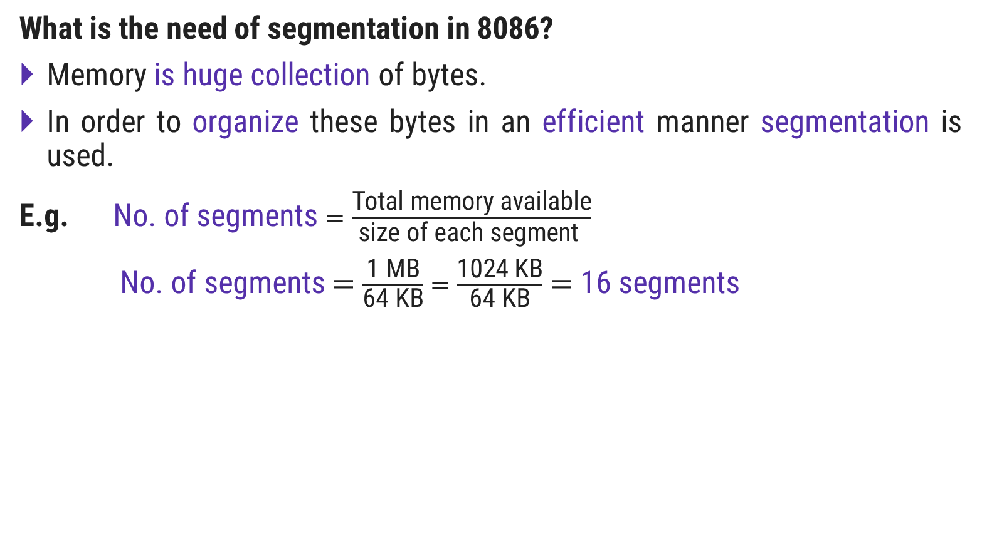
What is need of segmentation in 8086?
What is the need of segmentation in 8086?
Memory is huge collection of bytes.
In order to organize these bytes in an efficient manner segmentationis used.
E.g.No. of segments $=\frac{\text{Total} \text{memory} \text{available}}{\text{size} \text{of} \text{each} \text{segment} }$
No. of segments $=\frac{\text{1 }\text{MB}}{\text{64 }\text{KB}}=\frac{\text{1024 }\text{KB}}{\text{64 }\text{KB}}=$16 segments
1 MB
15
14
13
12
11
10
9
8
7
6
5
4
3
2
1
0
$$\text{64}\text{KB}$$

Slide 17
8086 Flag Register

Slide 18
8086 Flag Register
The 16-bit flag register of 8086 contains 9 active flags (6 conditional & 3 control flags), other 7 flags are undefined.
Flag Register (16-bit)
Control Flag
Status Flag
TF: Trap Flag
IF: Interrupt Flag
DF: Direction Flag
CF: Carry Flag
PF: Parity Flag
AF: Auxiliary Flag
ZF: Zero Flag
SF: Sign Flag
OF: Overflow Flag

Slide 19
8086 Flag Register
15
14
13
12
11
10
9
8
7
6
5
4
3
2
1
0
U
U
U
U
OF
DF
IF
TF
SF
ZF
U
AF
U
PF
U
CF
Interrupt Flag
IF=0 ; Disable Maskable Interrupt
IF=1 ; Enable Maskable Interrupt
Trap Flag is used for single step control.
TF=0 ; Whole program will be executed
TF=1 ; Program will run in single step mode.
Direction Flag
DF=0 ; String bytes are accessed from lower to higher memory address.
DF=1 ; String bytes are accessed from higher to lower memory address.
Overflow Flag
Indicates overflow, when arithmetic operation is carried out.
OF=0 ; result has not exceeded the capacity of machine.
OF=1 ; result has exceeded the capacity of machine.

Slide 20
8086 Flag Register
Carry Flag (CF): Set(1) if arithmetic operation results in carry; otherwise reset(0).
Auxiliary Flag (AF): If an operation performed in ALU generates a carry/barrow from lower nibble (i.e. D₀ – D₃) to upper nibble (i.e. D₄ – D₇), the AF flag is set i.e. carry given by D₃ bit to D₄ is AF flag. This is not a general-purpose flag, it is used internally by the processor to perform Binary to BCD conversion.
Parity Flag (PF): This flag is used to indicate the parity of result. If lower order 8-bits of the result contains even number of 1’s, the Parity Flag is set and for odd number of 1’s, the Parity Flag is reset.
Zero Flag (ZF): It is set(1), if the result of arithmetic or logical operation is zero else it is reset(0).
Sign Flag (SF): In sign magnitude format the sign of number is indicated by MSB bit. If the result of operation is negative, sign flag is set(1).

